Slide 1

About Me
Academically
Labor economics
Wages, employment, education, jobs, incentives, discrimination
Research – Empirical & GE Theory
Does growing college ed. worker preference affect income inequality?
Difference-in-differences
Is a lawyer in Champaign the same as in Chicago? (local labor markets)
ML – Unsupervised learning: clustering
Does the occ. composition of market power alter monopsony pricing results?
Gen. Method of Moments – IV: Shift-share
Personally
Grew up in a Seattle suburb
Undergrad in Wyoming

Slide 2
Welcome to Causality
UIUC ECON 474 Econometrics of Policy Evaluation

Slide 3

Correlation does not mean causality (1/4)
The sun rises after roosters crow
Roosters cause the sun to rise

Slide 4
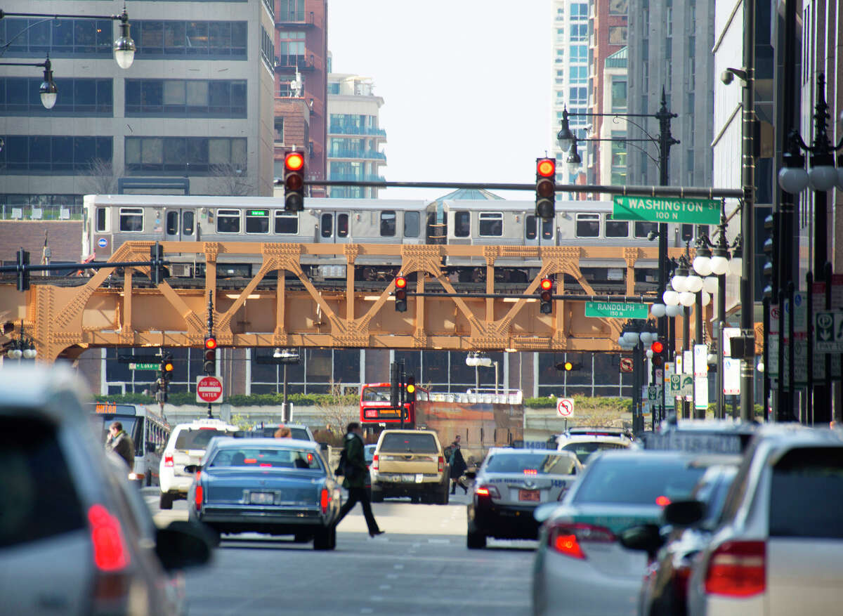
Correlation does not mean causality (2/4)
The traffic light changes to green after I inch forwards
Inching forwards causes the traffic light to change

Slide 5
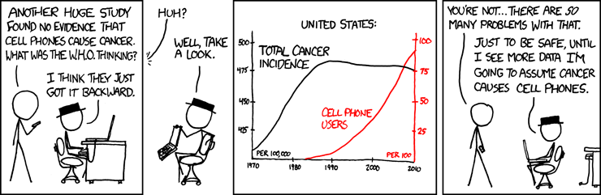
Correlation does not mean causality (3/4)

Slide 6
For more fun with spurious correlations:
https://www.tylervigen.com/spurious-correlations

Slide 7
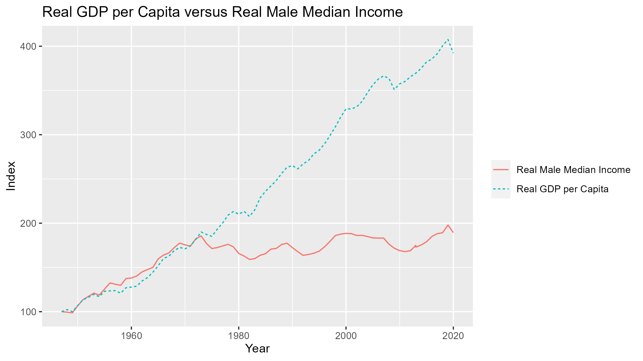
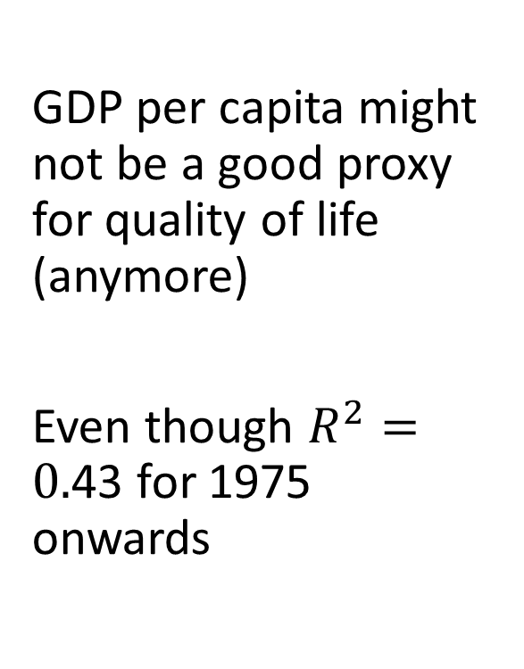
Correlation does not mean causality (4/4)
GDP per capita might not be a good proxy for quality of life (anymore)
Even though $R^{2}=0.$43 for 1975 onwards
Source: Census historical incomes and FRED BEA real GDP per capita

Slide 8
So, what are we doing in 474?
Big picture ideas

Slide 9
Agenda: answer causal questions & test theory
Government:
How is employment affected by raising the minimum wage?
Do housing vouchers for high-poverty households have economic benefits?
Will gender education equality promote economic growth in developing counties?
Business:
Which demographic is most responsive to marketing?
Does a modified graphical user interface (GUI) increase retention?
Which local market will provide the most revenue for a new establishment?
Individual:
What are the expected lifetime earnings benefits of finishing my college degree?
Does having health insurance make me healthier?
What are the expected career consequences of having children?
How can I win march madness?

Slide 10
Identifying causality is non-trivial
1. Simplest case: experimental data
Design a randomized experiment
Control group
Treatment group
t-test
Complications
Internal validity: well-defined experiment and casually identified
Statistical analysis answers question
Compliance: control cannot be treated and vice versa
External validity: experiment represents desired population
Unrepresentative sample
Humans exist in a society (general equilibrium spillovers)
2. Complex case: observational data
Natural experiments - messy
Policy changes
Recessions are geographically heterogeneous
Court rulings
Decisions made by thresholds
Counterfactual – What otherwise would have happened without treatment?

Slide 11

Counterfactuals

Slide 12
Real world data are messy
Endogeneity (selection)
Unlike experimental objects in physics, you make decisions conditional on your preferences and the world around you
College major
What stuff to buy
How to commute to class
What social media to follow
Omitted variable bias (OVB)
Effect of college on wages?
Wages = f(Ed, Exp, ability, background, etc.)
Measurement error
People overstate time working
Inherent business audit error & GDP
Sample endogeneity
Declining survey response rates
Who chooses to respond
Who is selected by data collection criteria
Small treatment doses
Signals in irreducible statistical noise
Effect of one new bus line on Chicago commute times
Small effect on existing bus network
Majority of people don’t commute by bus
These complications exist in experimental data too!

Slide 13
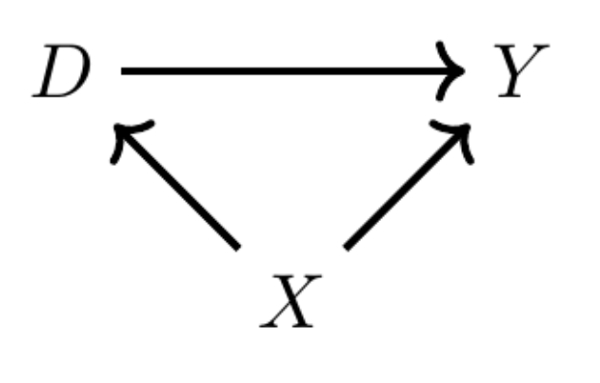
Frameworks – Identifying potential complications
Directed Acyclic Graph (DAG)
Causal path
Potential Outcomes
Thinking about counterfactuals
Comparing two states of the world
“Is the expected treatment effect on one individual
the same as
the expected treatment effect on treatment group vs. control group?”

Slide 14
Techniques to address selection bias (endogeneity)
Randomized Experiments
You choose treatment status
Instrumental Variables (IV)
Another variable chooses treatment status
Regression Discontinuity Design (RDD)
A threshold chooses treatment status
Difference-in-Differences (DiD)
An event (policy change, recession, etc.) chooses treatment status
All techniques make assumptions and have limitations

Slide 15
1. Randomized Experiments
Treatment identification
Randomly assigned by researcher (you)
Identification questions
What is your desired population?
How to randomize treatment?
Size of groups?
What is treatment mechanism and its size?
Examples
RAND health-care experiment
Effect of health insurance on health-care utilization
Thornton (2008) HIV experiment
Does cash incentivize learning about HIV status and affect risky actions?

Slide 16
2. Instrumental Variables – Two Stage Least Squares
Treatment identification
By variable (instrument) predictive of treatment status
Identification questions
Is instrument as good as randomly assigned?
Inclusion restriction:
Is instrument a strong treatment status predictor?
Exclusion restriction:
Does IV affect outcome variable only through treatment variable?
Example
Wright (1928) Estimating demand and supply elasticities of vegetable oils
Price & quantity outcomes are fundamentally equilibrium outcomes
Not points along S&D
Need to use “shocks” to demand to trace supply curve
P
S
D
Q

Slide 17
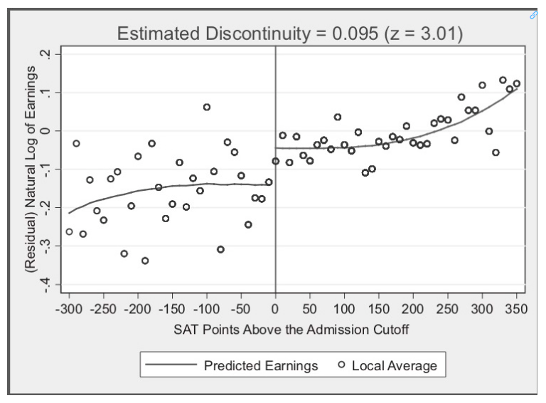
3. Regression Discontinuity Designs (RDD)
Treatment identification
Above or below some threshold of a running variable
Identification questions
Is threshold value as good as randomly assigned?
Is treatment discontinuous at threshold?
Can individuals manipulate running variable value (i.e. treatment status/bunching)?
Does anything else occur at the threshold?
Example
Hoekstra (2009)
Effect of attending state flagship university on earnings

Slide 18
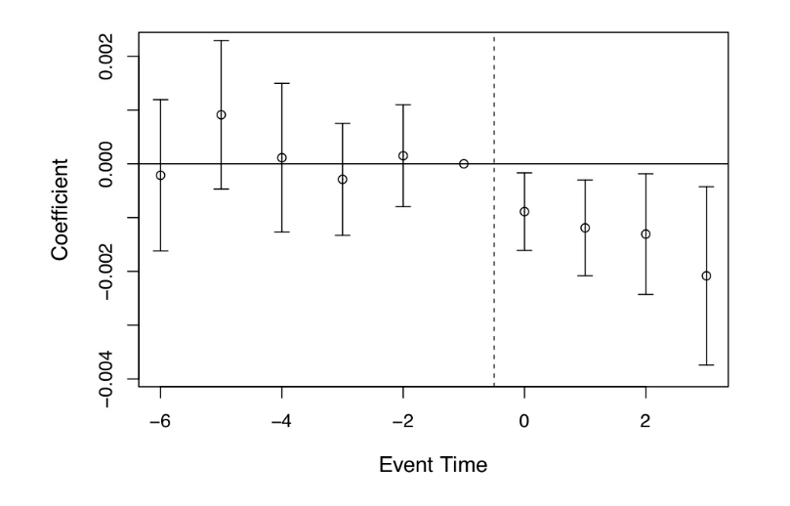
4. Difference-in-Differences (DiD) – Time Series
Treatment identification
Determined by some event:
Policy change, economic event, natural event, etc.
Identification questions
Is the control group a representative counterfactual?
Do both groups have parallel pre-trends?
What level is treatment applied?
Example
Miller et al (2019)
Effect of Medicaid expansion on annual mortality

Slide 19
A question
Who is treatment assigned to?
Treatment example:
Minimum wage increase for Seattle
Bachelor’s degree

Slide 20
A concluding thought
Causal inference requires deep institutional knowledge because of endogeneity.
In practice, you are simply running regressions.
Need to know:
Is question identifiable? Which type of regression? Which variables? What is the causal mechanism? What are confounding factors (OVB)?
Consequently, cannot be automated.
Being able to identify causality distinguishes you from other analysts
And it is empowering

Slide 21
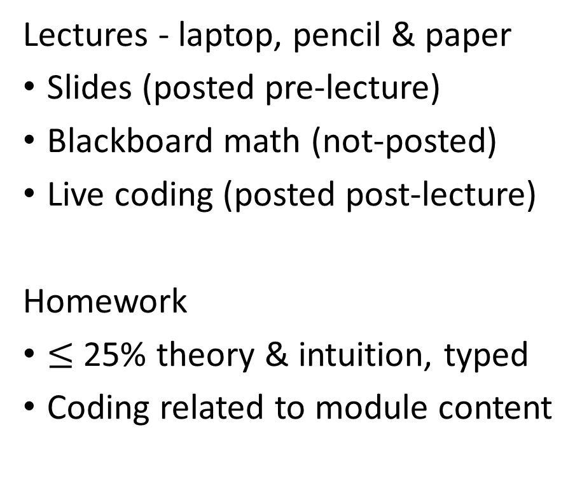
What to expect from 474 content
Lectures - laptop, pencil & paper
Slides (posted pre-lecture)
Blackboard math (not-posted)
Live coding (posted post-lecture)
Homework
$≤$ 25% theory & intuition, typed
Coding related to module content
Exams
Theory & intuition
Similar to homework difficulty
Delivered during lecture time
Final Project
Guided paper replication
Chose 1 from 3-4 papers

Slide 22
Next time on causality and you
Install
R & RStudio
R Markdown
Bring your computer
R coding resources:
Hands-On Programming with R
R for Data Science (R4DS)
R Markdown: The Definitive Guide

